Slide 1


Microsoft SharePoint Sites
mintesnot

Slide 2

What is a SharePoint Site?
Key differences Classic Vs Modern
Key Features
Components of SharePoint
Integrate with Microsoft 365 Ecosystem
SharePoint Version Evolution
Types of SharePoint Users
SharePoint Admin Center
SharePoint Vs OneDrive

Slide 3
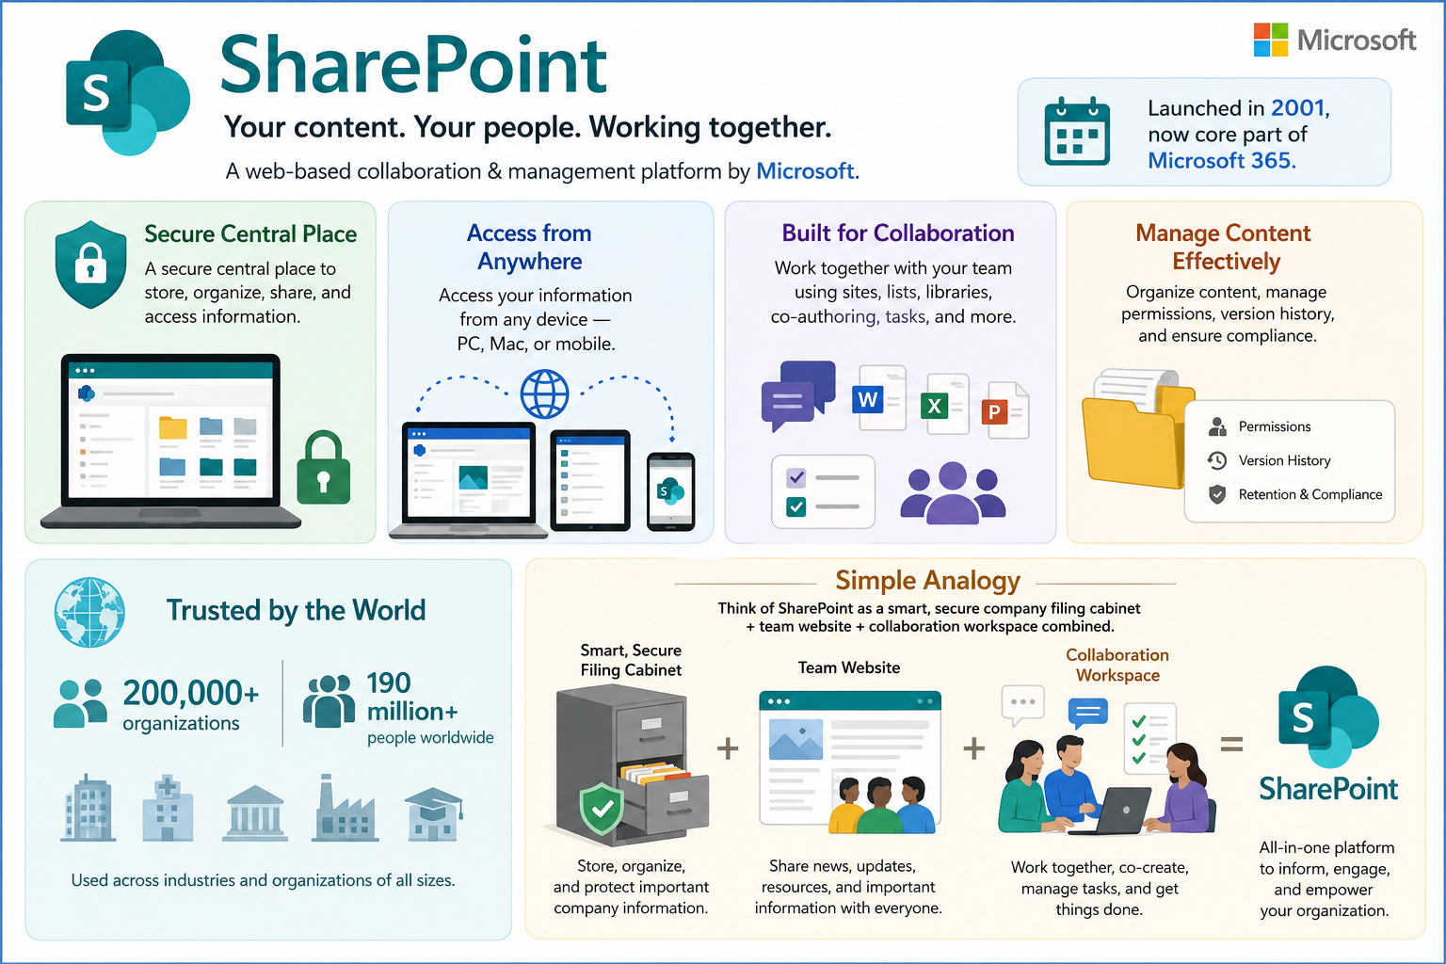
What is a SharePoint Site?
A SharePoint Site is a collaborative workspace used to:
Store documents
Share information
Manage content
Collaborate with teams
Automate business processes

Slide 4
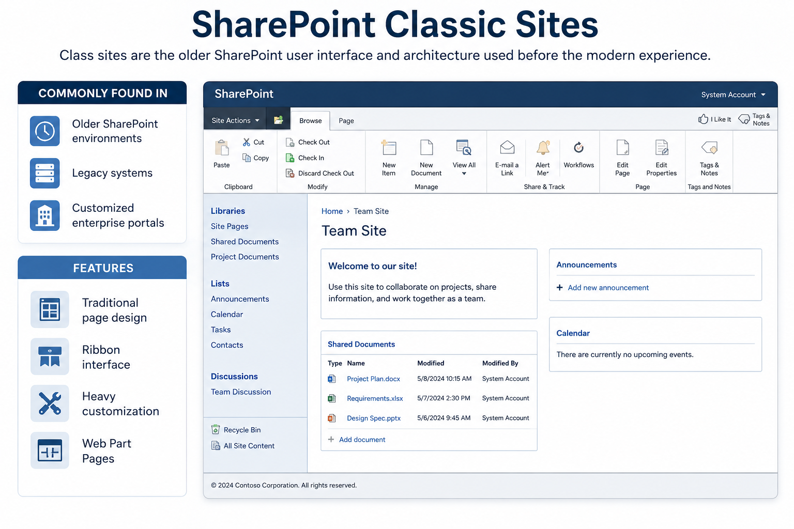
Classic Sites
Class sites are the older SharePoint user interface and architecture used before the modern experience.
They are commonly found in
Older SharePoint environments
Legacy systems
Customized enterprise portals
Features
Traditional page design
Ribbon interface
Heavy customization
Web Part Pages

Slide 5
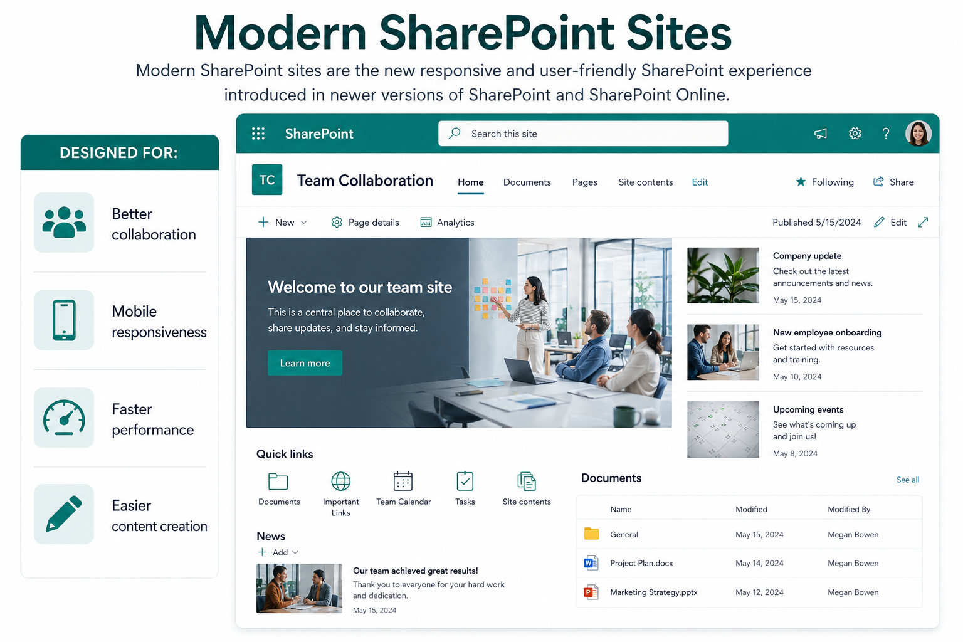
Modern Sites
Modern SharePoint sites are the new responsive and user-friendly SharePoint experience introduced in newer versions of SharePoint and SharePoint Online.
Designed for:
Better collaboration
Mobile responsiveness
Faster performance
Easier content creation

Slide 6
Architectural & Design Core
The most fundamental shift isn’t just cosmetic; it’s how data and sites are structured.
Feature | Classic Experience | Modern Experience
Site Architecture | Deep Hierarchies: Relies on a single top-level Site Collection with multiple nested subsites (parent-child relationship). Rigid and hard to recognize. | Flat Architecture: Every site is an independent Site Collection. Reorganizations are managed dynamically using Hub Sites to group related sites together.
Mobile Responsiveness | Poor/Manual: Pages do not scale automatically. Requires extensive custom CSS or separate mobile views to look decent on a phone. | Native Responsiveness: Every page, list, library, and web part adapts automatically to mobile devices, tablets, and desktops out-of-the-box.
Branding & Layout | Rigid Layouts / High Code: Uses master pages, alternative CSS, and fixed web part zones. Changing layout configurations after creation is nearly impossible. | Flexible Layout / Low Code: Uses can be updated on the fly using a drag-and-drop editor. No master pages.

Slide 7
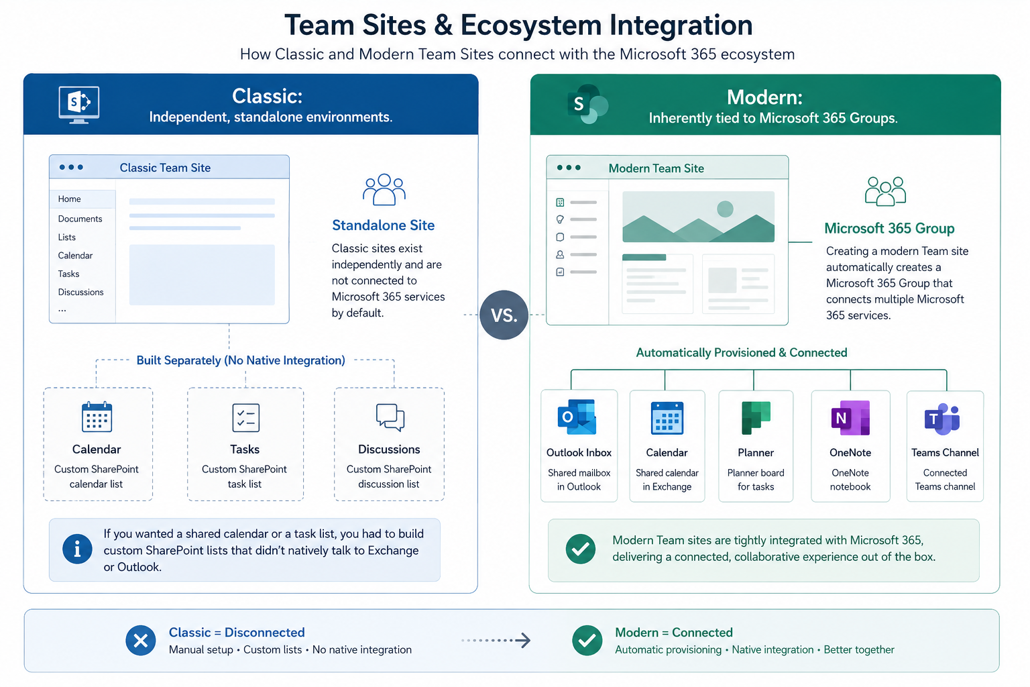
Technical & Functional Breakdown
Team Sites & Ecosystem Integration
Classic: Independent, standalone environments. If you wanted a shared calendar or a task list, you had to build custom SharePoint lists that didn’t natively talk to Exchange or Outlook.
Modern: Inherently tied to Microsoft 365 Groups. Creating a modern Team site automatically provisions a shared Outlook inbox, an Exchange calendar, a Planner board, a OneNote notebook, and a Microsoft Teams channel.

Slide 8
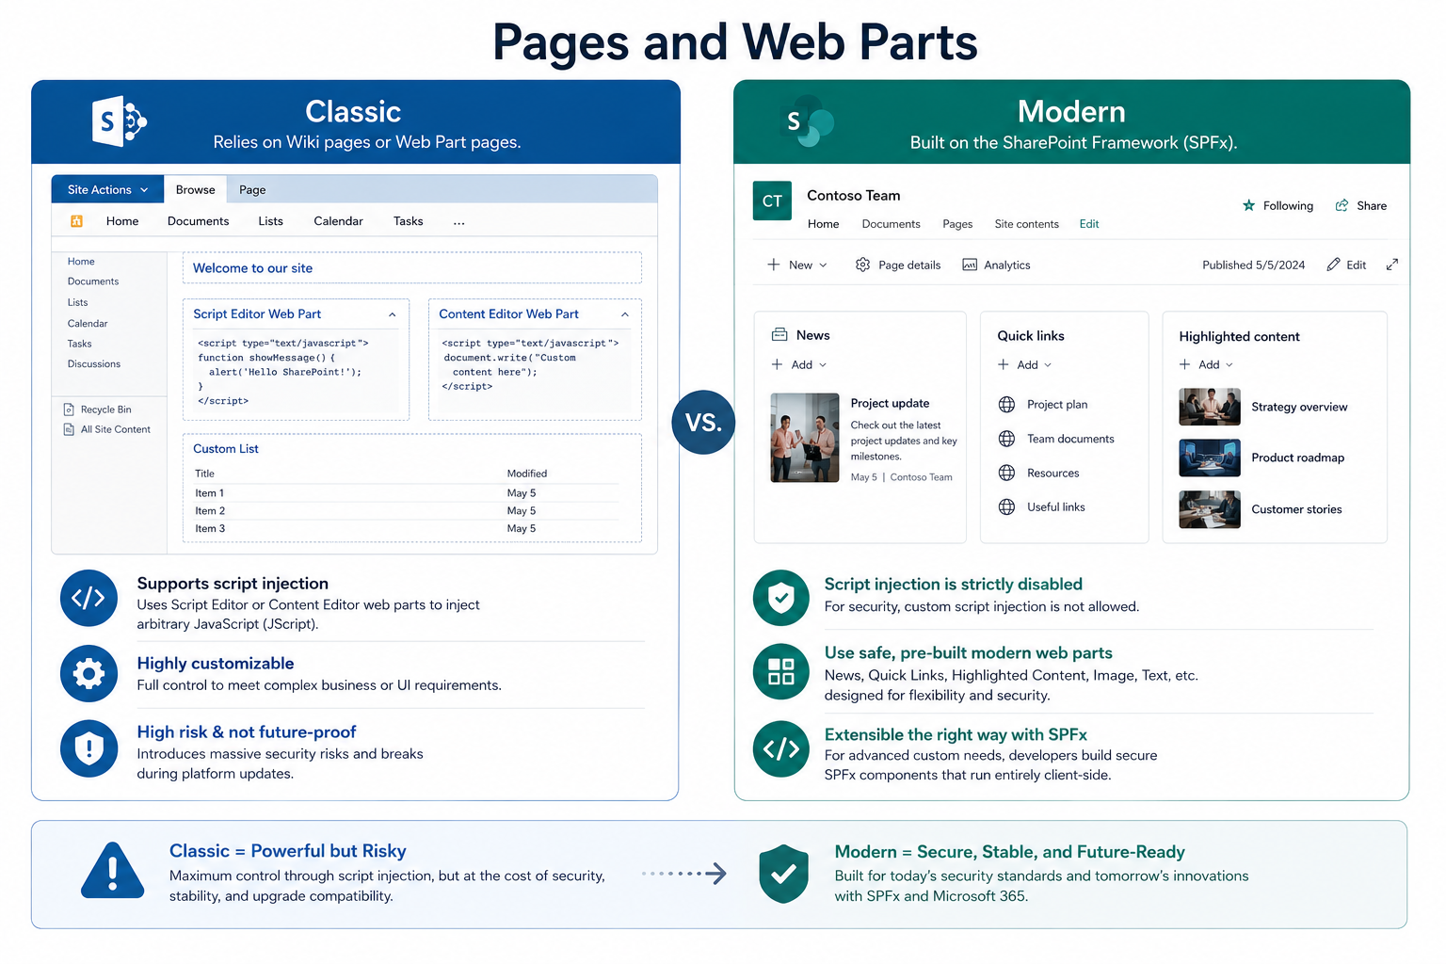
…
Pages and Web Parts
Classic: Relies on Wiki pages or Web Part pages. It supports the execution of custom script injections (like Script Editor or Content Editor web parts), allowing developers to inject arbitrary JavaScript (JScript). While highly customizable, this introduces massive security risks and breaks during platform updates.
Modern: Built on the SharePoint Framework (SPFx). Script injection is strictly disabled for security. Instead, users utilize safe, pre-built modern web parts (News, Quick Links, Highlighted Content). For advanced custom needs, developers build secure SPFx components that run entirely client-side.

Slide 9
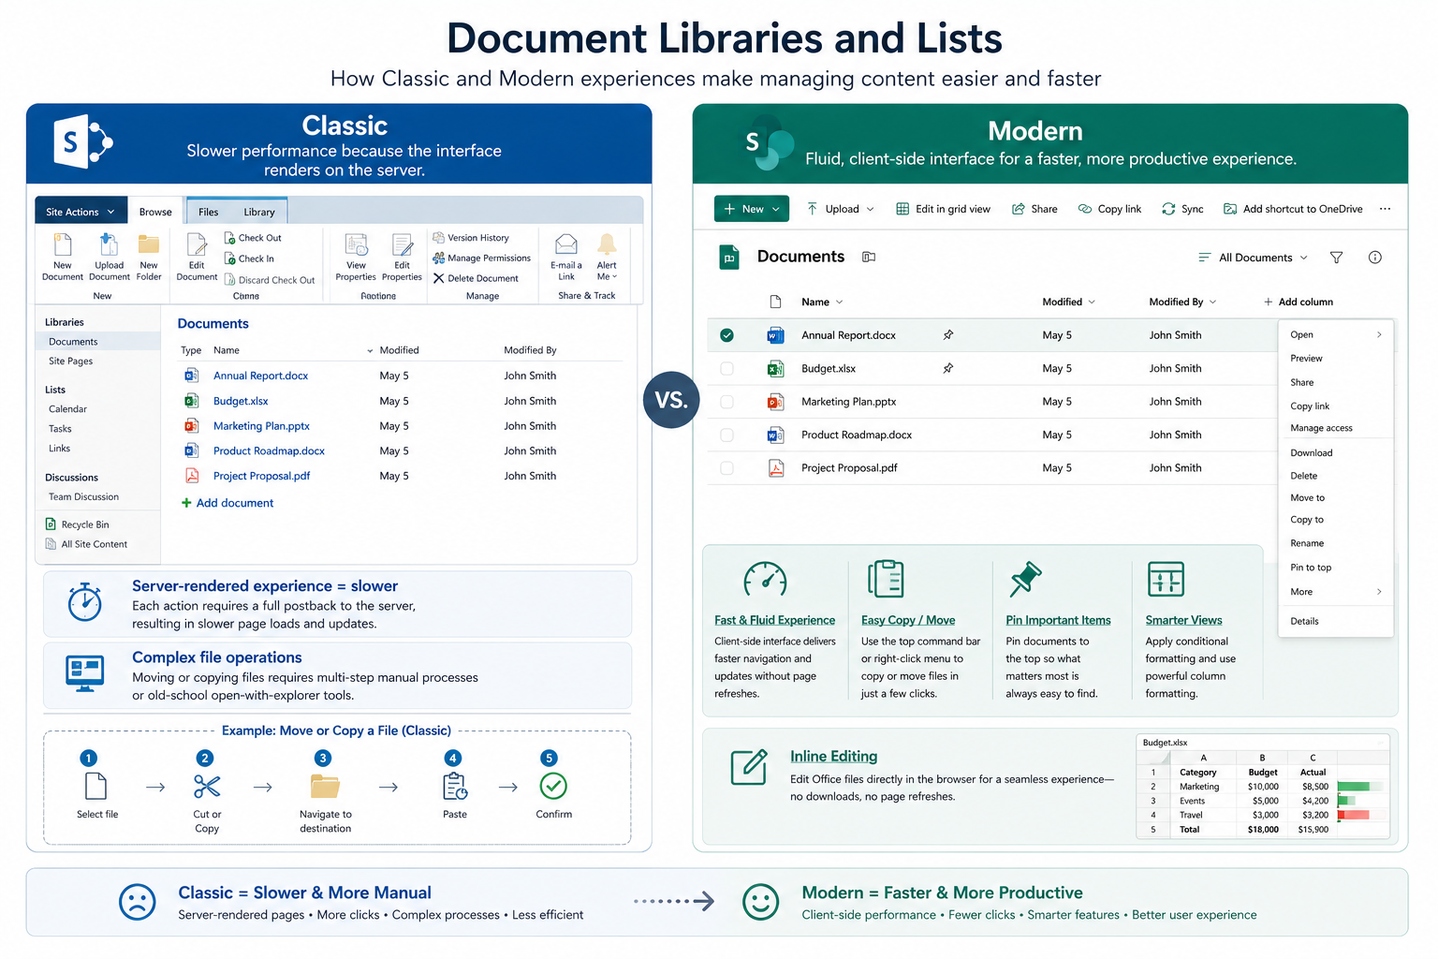
…
Document Libraries and Lists
Classic: Slower performance because the interface renders on the server. Moving or copying files requires multi-step manual processes or old-school open-with-explorer tools.
Modern: Fluid, client-side interface. Users can easily copy/move files using a top command bar, pin important documents to the top, apply conditional formatting, and perform inline editing without page refreshes.

Slide 10
Key Differences: Classic Vs. Modern
Feature | Classic Sites | Modern Sites
User Interface | Outdated ribbon interface, cluttered, less intuitive | Clean, modern, intuitive, command bar; highly visual
Mobile Responsiveness | Limited; requires custom work | Full responsive; excellent on phones, tablets, desktops
Architecture | Subsite hierarchy (complex navigation & permissions) | Flat architecture; independent sites connected via Hub Sites
Microsoft 365 Groups | No native integration | Team sites are connected to M365 Groups (Teams, Planner, etc.).
Pages & Web Parts | Classic web parts, wiki pages; more coding needed | Modern web parts (drag-and-drop); responsive pages
Lists & Libraries | Older view; full page reloads | Faster, inline editing, conditional formatting, quick filters
Search | Classic search experience | Microsoft Search (more intelligent, contextual)
Performance | Slower, especially with customizations | Faster load times and better scalability
Customization | Deep (master pages, custom code, farm solutions) | Easier (themes, SPFx, extensions); less code required
Integration | Limited with modern Microsoft 365 tools | Seamless with Teams, Power Automate, Power Apps, etc.

Slide 11
Comparison Table
Feature | Classic Site | Modern Site
Interface | Traditional | Modern UI
Mobile Friendly | ❌ No | ✅ Yes
Performance | Slower | Faster
Customization | Slower | Faster
User Experience | Complex | Simple
Microsoft 365 Integration | Limited | Strong
Responsive Design | No | Yes
Future Support | Limited | Recommended

Slide 12
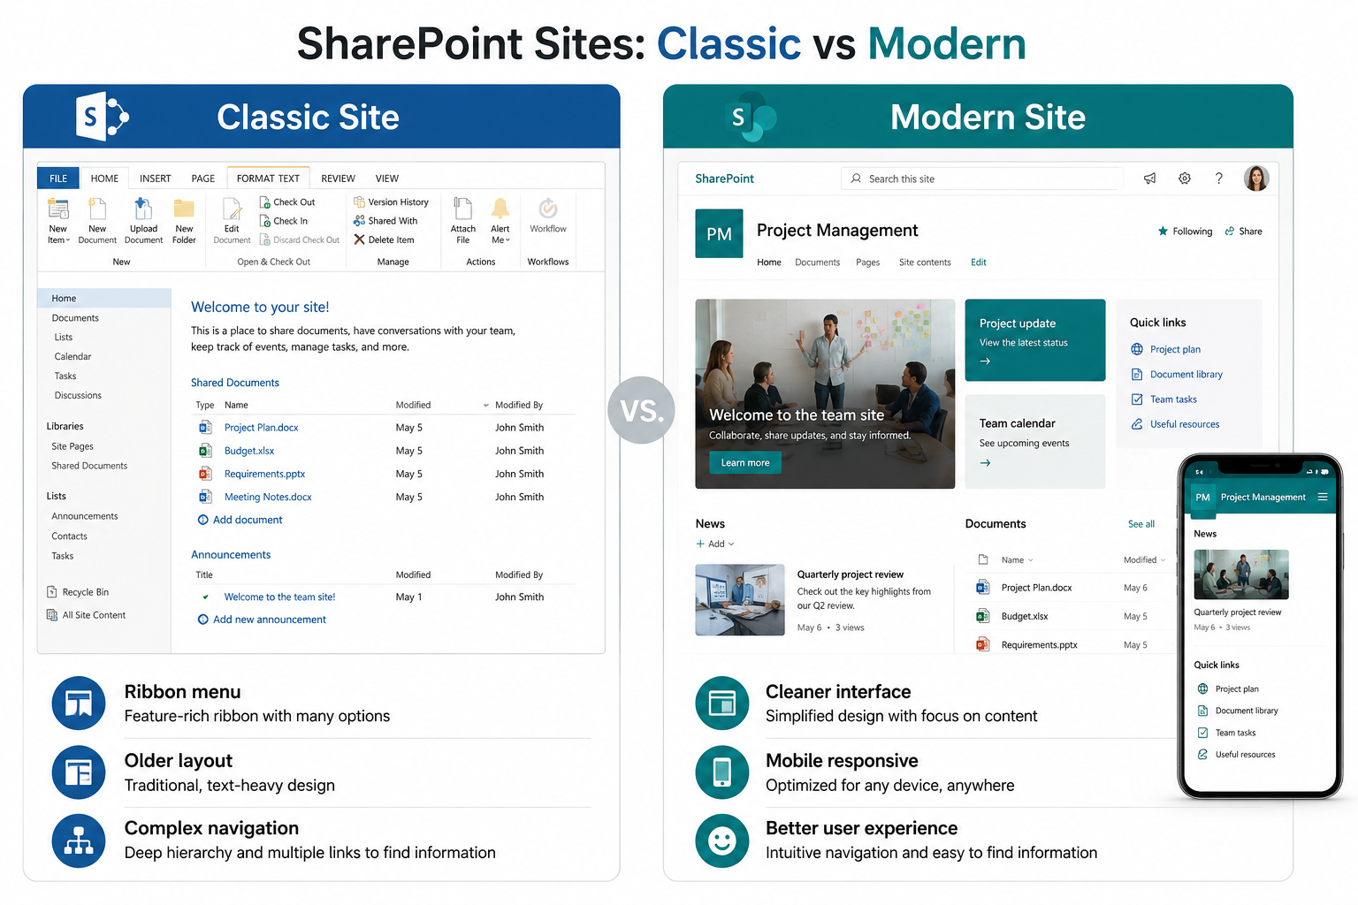
Visual Comparison
Classic Site
Ribbon menu
Older layout
Complex navigation
Modern Site
Cleaner interface
Mobile responsive
Better user experience

Slide 13
SharePoint Site Collection
A site collection is a logical container (grouping) in SharePoint consisting of:
One top-level site + any associated subsites (in classic setups).
Shared administrative settings, features, permissions, quotas, and content databases (in on-premises).
It serves as a boundary for:
Permissions & security
Site features & templates
Storage quotas
Navigation & branding (in classic)
Modern Note: In SharePoint Online / Microsoft 365, every new site is essentially its own site collection (flat model), and we often just call them “sites”.

Slide 14
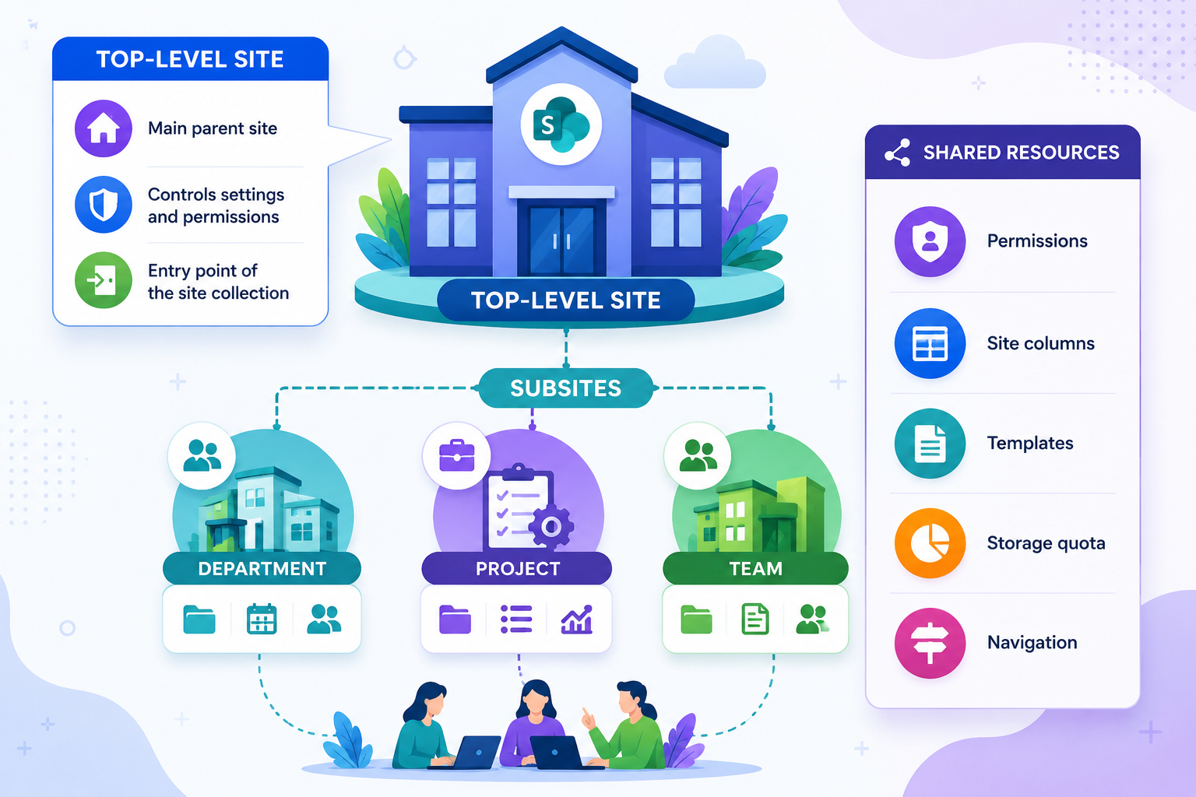
Components of a Site Collection
Top-Level Site
Main parent site
Controls settings and permissions
Entry point of the site collection
Subsites
Child sites created under the parent site
Used for departments or projects
Shared Resources
Permissions
Site columns
Templates
Storage quota
Navigation

Slide 15
Key Features of Site Collections
Unique URL (e.g., craftsofttech.sharepoint.com/sites/Department).
Independent permissions (own owners, members, visitors).
Site collection features (e.g., workflows, content types, custom solutions).
Storage quota & resource management.
Recycle bin scoped at collection level.
Support for content types, templates, and apps.
Integration with Microsoft 365 Groups (for Team Sites).

Slide 16

Site Collection Vs. Site Vs. Subsite
Concept | Description | Modern Recommendation
Site Collection | Top-level container with shared settings | Every new “site” is one
Site | The actual workspace (Team or Communication) | Primary building block
Subsite | Nested site under a collection | Avoid – use separate sites + Hubs
Rule of thumb: Create a new site (site collection) for each discrete unit of work, team, project, or department.

